Slide 1

WEB TECHNOLOGIES II
UE16CS403

Slide 2
Vidhu Rojit Dept of CSE, PESU Email: vidhu.Tjit@GMAIL.COM B-G03,CSE STAFF ROOM,GROUND FLOOR
ABOUT THE INSTRUCTOR

Slide 3
RULES

Slide 4



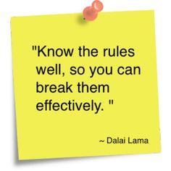
Late to class???

Slide 5


Slide 6
A STEP BACK in TIME
Web Technologies - I

Slide 7


Slide 8
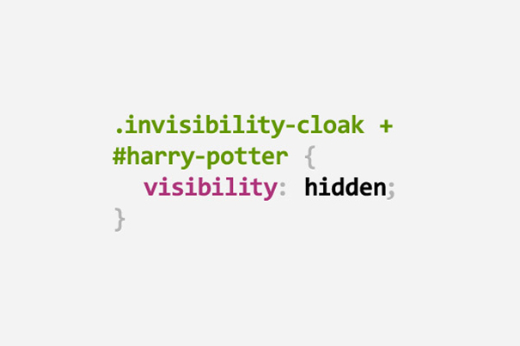

Slide 9
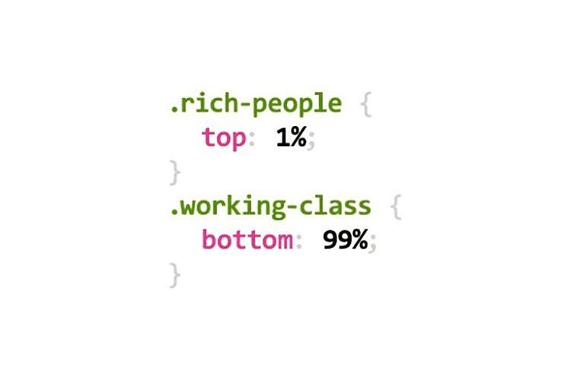

Slide 10
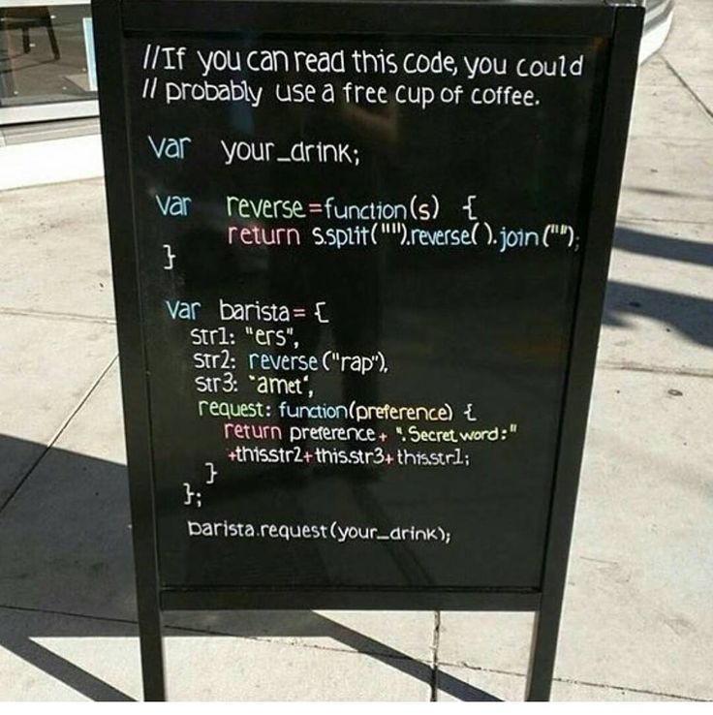

Slide 11


Slide 12
A PEEP INTO the FUTURE
WEB TECHNOLOGIES -II

Slide 13


Slide 14
Textbooks
T1 | Professional AJAX - Nicholas C Zakas et al
T2 | AJAX, The Complete Reference – Thomas. A. Powell
T3 | Angular JS Up and Running - Shyam Sheshadri and Brad Green
T4 | Handouts for Web Services, Web Sockets, HTTP 2.0 protocol, Node.js, JS Prototype and CORS

Slide 15
WHERE DO WE START???

Slide 16
JAVASCRIPT OBJECTS

Slide 17
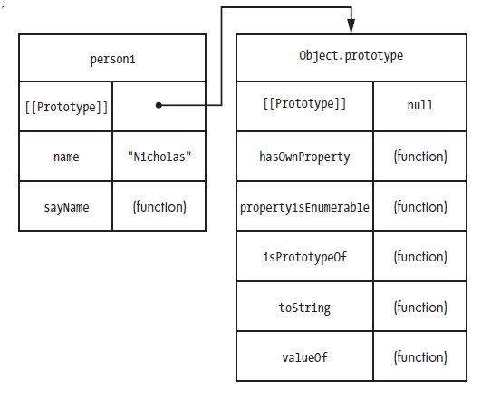

Slide 18
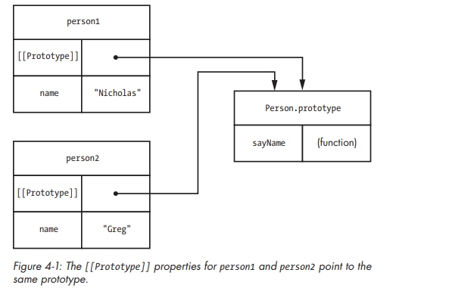

Slide 19
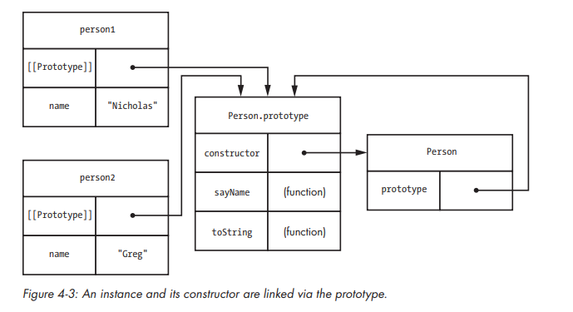

Slide 20
